Slide 2
Make Your Bed

Slide 3
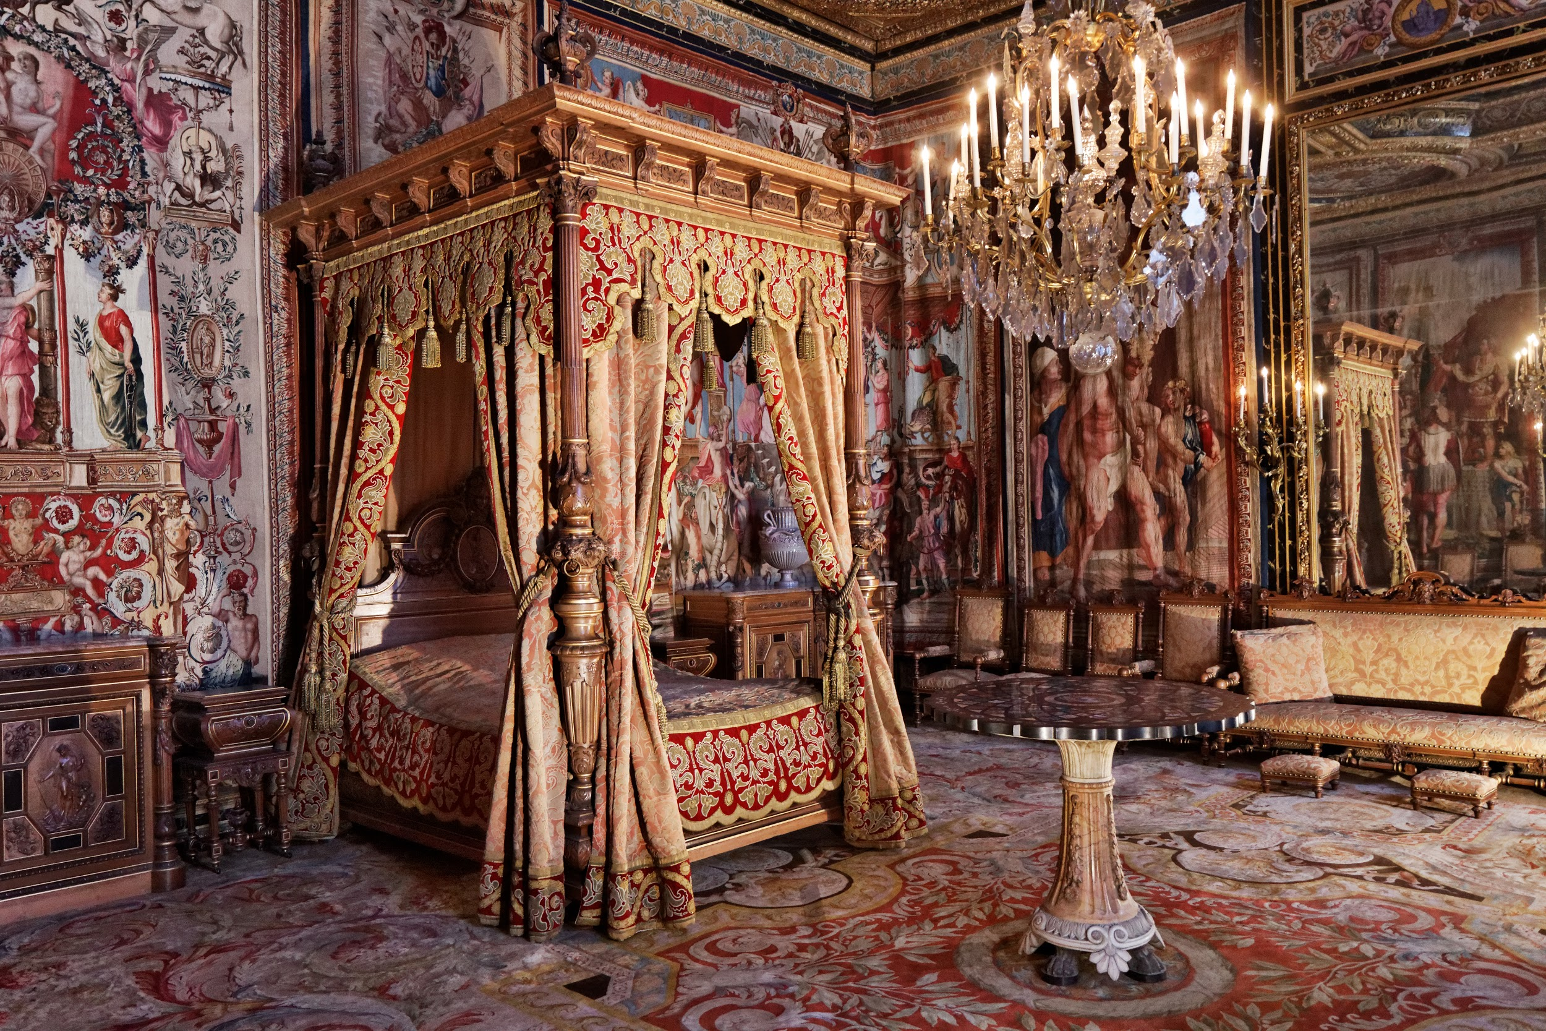

Slide 4
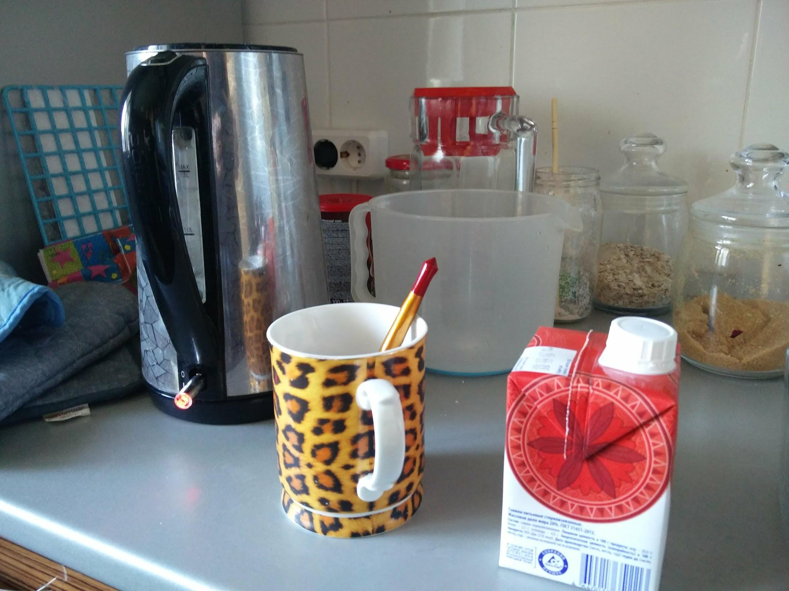
Goal Setting:
How to Reach the
Objective

Slide 5

Relax

Slide 6
for I have learned
to be content
Philippians 4:11b
in any circumstance

Slide 7
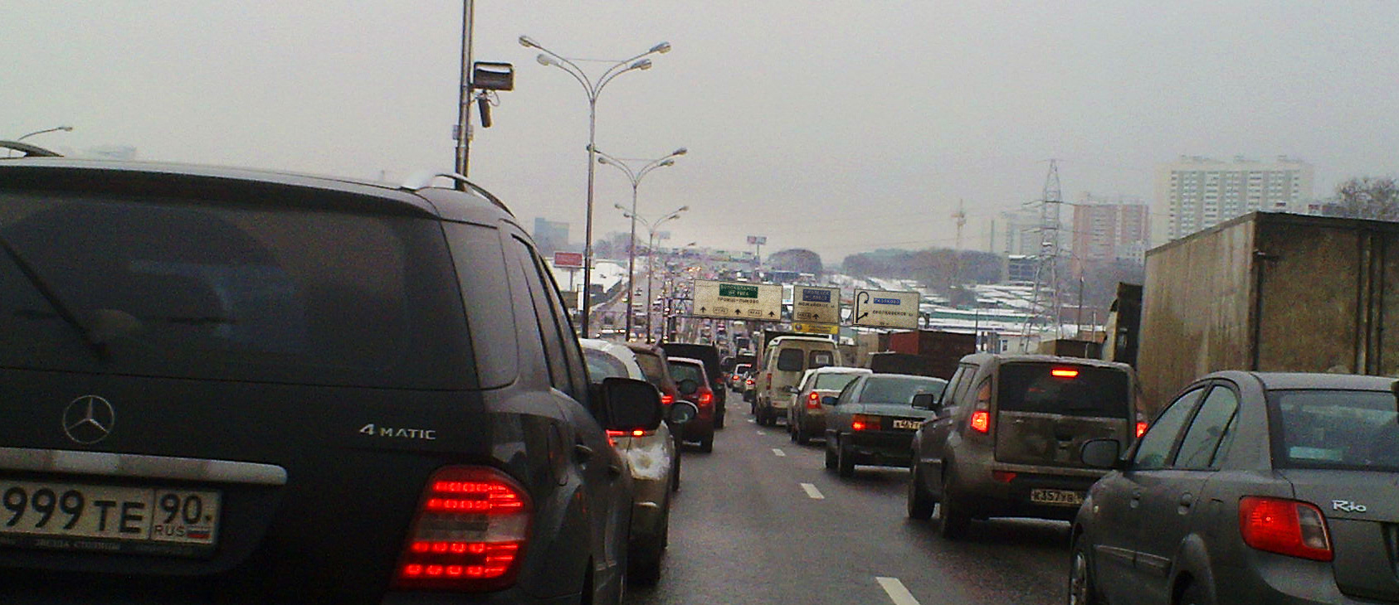

Slide 10
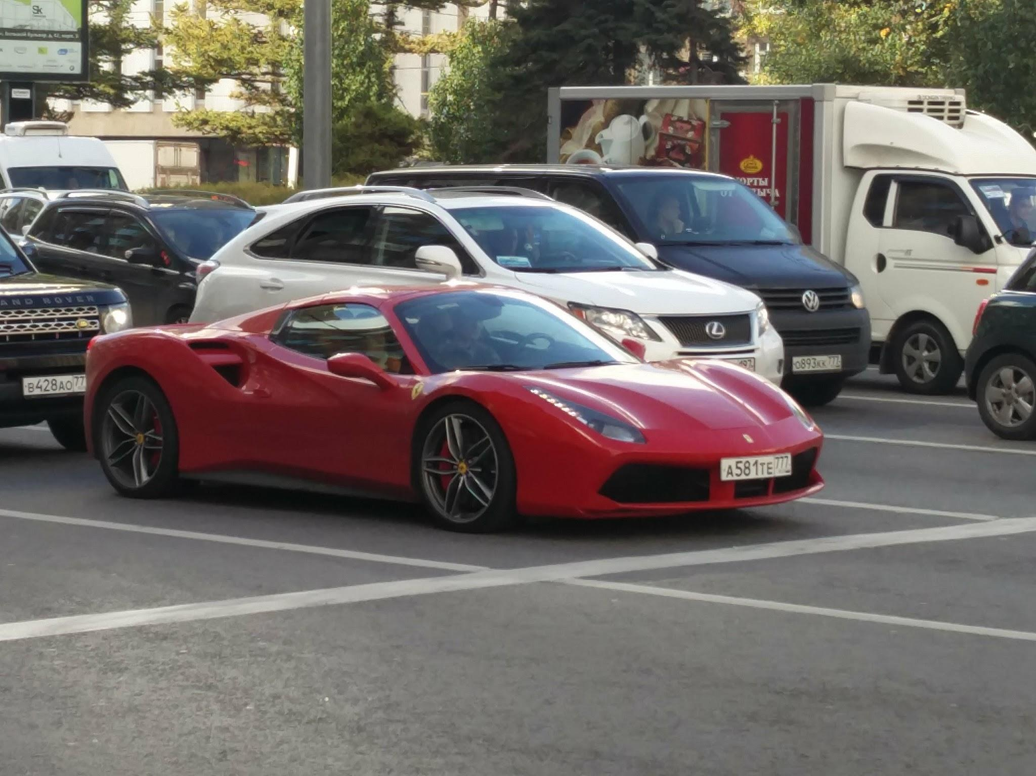

Slide 11


Slide 13
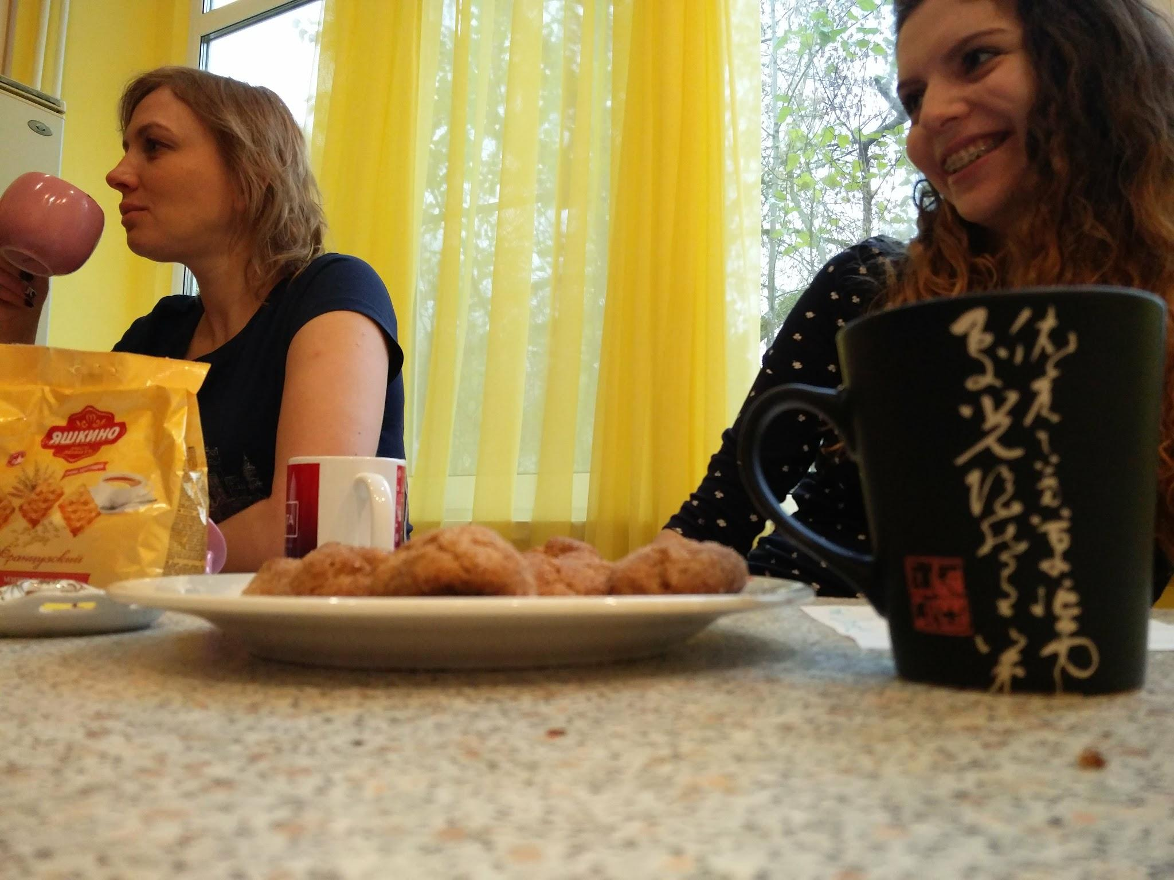

Slide 14
Paul and Silas
Acts 16:23-25
David
Psalm 23:5

Slide 15
Be content
NOT satisfied

Slide 16
Only the paranoid survive

Slide 17
It is always Day 1

Slide 18
You’re only as good as your last burger.
David Jordan

Slide 19
transformed
renewing of your mind
test and approve what is the will of God
good, well-pleasing, perfect
Romans 12:2b

Slide 20
Focusing Question

Slide 21
What’s the one thing I can do
such that by doing it
everything else
will be easier or unnecessary?

